Slide 1
Param
Virtual Voice Assitance

Slide 2
PROBLEM STATEMENT:
To write a program to create a Virtual Voice Assistant in Python by Speech recognition using inbuilt API(Application Programming Interface) helping convert input audio to text aiding in performing certain tasks as per user request.
User can give commands to perform various tasks such as searching anything on google and Wikipedia, opening a website, playing songs from the user's system, viewing news headlines, search for a place in google maps, ask to show the time, set an alarm and timer, tell jokes or greet the user. The user can suspend the voice assistant by saying "Thank You" or “Bye".

Slide 3
SYSTEM ARCHITECTURE:
Speech Recognition (using google Speech recognition API)
User Input
(Speech)
Processing of User Input based on Trigger Words
Opening URL’s, Playing Music, Setting an Alarm or Timer, etc
Output according to User Input in text and audio

Slide 4
. LIBRARIES USED:
pyttsx3-pyttsx3 is a text-to-speech conversion library in Python. The pyttsx3 module supports two voices which include a female and a male voice, provided by “sapi5” for windows.
speech_recognition as sr- Speech recognition is a machine's ability to listen to spoken words and identify them. SpeechRecognition library has many classes but in our project we have used a class called Recognizer. This is the class that will help us to convert audio files into text.
wikipedia-Wikipedia is a Python library that makes it easy to access and parse data from Wikipedia.
datetime -datetime is a module used to work with dates and times.
json -Python comes with a built-in package called json for encoding and decoding JSON data.
urllib.request -The urllib.request module defines functions and classes which help in opening URLs.
playsound -The playsound module is a cross platform module that can play audio files. It works with both WAV and MP3 files.

Slide 5
webbrowser -The webbrowser module provides a high-level interface to allow displaying web-based documents to users.
pywhatkit - pywhatkit is a simple and powerful Python library with many useful features such as Playing a YouTube video, Performing a Google Search, Getting information on a particular topic and Sending WhatsApp messages. In this program pywhatkit has been used solely for the purpose of performing a google search.
os - The OS module in Python provides functions for interacting with the operating system like creating and removing a directory (folder), fetching its contents,etc.
pyjokes - he pyjokes is a python library that helps to create one-liner jokes.
re(regular expression) - A regular expression specifies a set of strings that matches it; the functions in this module let you check if a particular string matches a given regular expression.
time - time module in Python provides various time-related functions

Slide 6
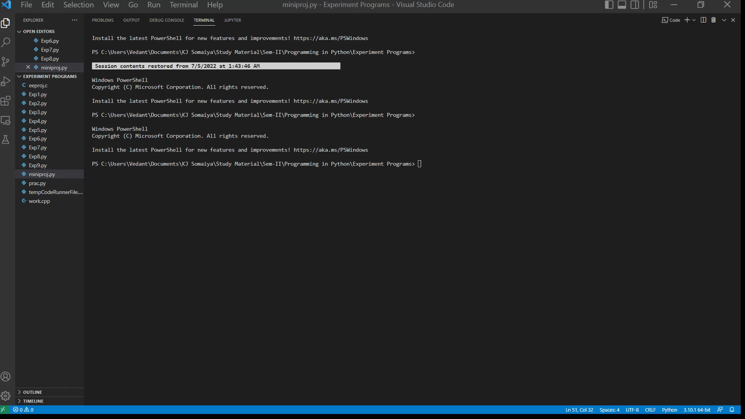
Result/Output:
The Youtube was opened but the screen recorder wasn’t able to capture it, as it was set to capture the window rather than the entire screen

